Slide 1
PARK HEIGHTS ENTREPRENEURSHIP TRAINING GRANT Bidders’ Conference December 14, 2023
Notes:
Use Avenir Next Demi Bold 60 point for the title
Use Avenir Next Ultra Light 24 point for the subtext
All text should be center aligned

Slide 2
INTRODUCTIONS
Joanna Bartholomew – Assistant Director, Chief of Strategic Initiatives
Joanna.Bartholomew@baltimorecity.gov
Angela Harrison - Grant and Policy Writer
Angela.Harrison@baltimorecity.gov
Please put your name, title and organization in the chat

Slide 3
Park Heights Entrepreneurship Training Grant Overview MOED has received funding for economic and career development projects in the Park Heights Master Plan Area, including to support entrepreneurs and small business start-ups. A grant of up to $76,000 will be awarded to an organization offering entrepreneurship training to Park Heights residents. The grant winner will work to connect residents interested in entrepreneurship and innovation to training resources to assist them in preparing a business plan, applying for loans, obtaining credit, understanding business taxes, and gaining other essential knowledge. The project will also award grants of at least $2,500 for start-up costs to selected participants through a pitch competition.
Notes:
Use Avenir Next Demi Bold 44 point for the slide title
Use Avenir Next Ultra Light 28 point for the subtext
All text should be left aligned
Utilize square bullet points instead of round to create a modern feel

Slide 4
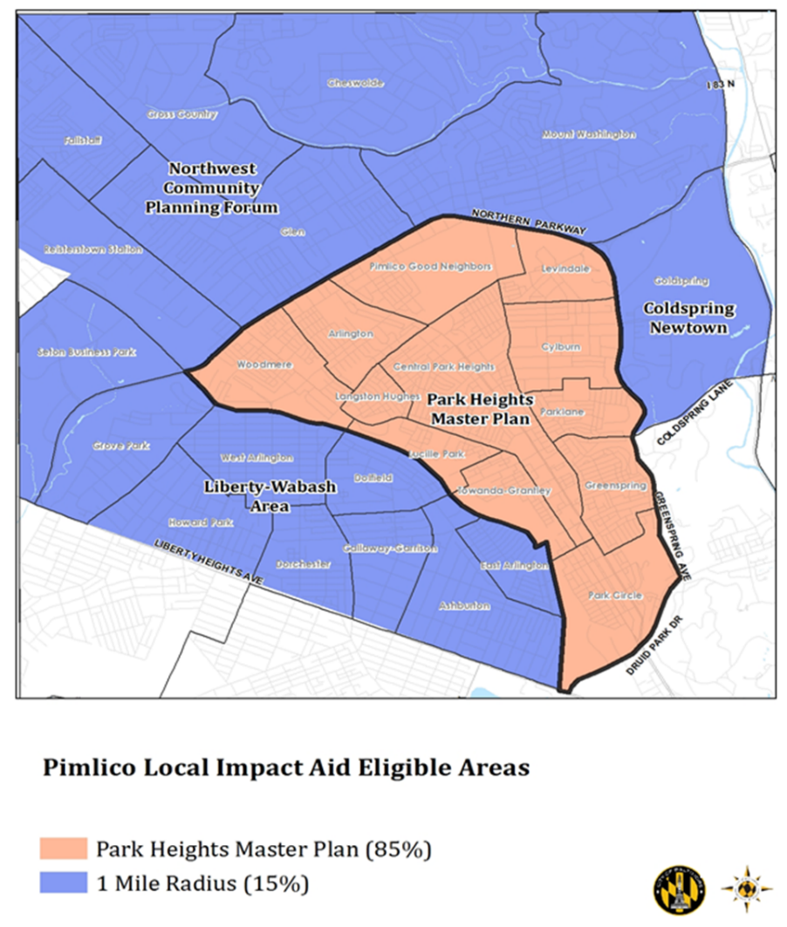
Park Heights Master Plan Service Area
Proposed programs must serve residents within the Park Heights Master Plan area (orange)
Programs should also develop partnerships with community organizations within the Master Plan area (orange) or within a 1-mile radius (blue)
Notes:
Use Avenir Next Demi Bold 44 point for the slide title
Use Avenir Next Ultra Light 28 point for the subtext
All text should be left aligned
Utilize square bullet points instead of round to create a modern feel

Slide 5
Entrepreneurial Training Requirements
The proposed training must include the following elements:
Consistency with a race equity and inclusion framework
Curriculum following a national model or based on nationally recognized standards of entrepreneurship education
Opportunities for mentorship experiences with local businesses or executive leadership
Case management services, including use of the Unite Us tool to refer participants to partner organizations for barrier removal and other supports
A culminating pitch competition for participants who complete training, to include awards of subsidies no less than $2,500 for business start-up costs
Notes:
Use Avenir Next Demi Bold 44 point for the slide title
Use Avenir Next Ultra Light 28 point for the subtext
All text should be left aligned
Utilize square bullet points instead of round to create a modern feel

Slide 6
Applicant Qualification Requirements
The selected vendor must have the following qualifications:
5-10 years experience working with the target population and local businesses
Ability to deliver effective entrepreneurship training curriculum
Familiarity with and capacity to deliver curriculum related to key business start-up components, such as business plans, banking and tax planning, investor pitch strategies, etc.
Capacity to meet all reporting and monitoring requirements
Minimum three months operating capital on hand throughout the contract term
Notes:
Use Avenir Next Demi Bold 44 point for the slide title
Use Avenir Next Ultra Light 28 point for the subtext
All text should be left aligned
Utilize square bullet points instead of round to create a modern feel

Slide 7
Outcomes
At least 40 participants will be enrolled in training
At least 75% of enrolled participants will complete training
All participants completing training will develop a functional business plan, and be able to
provide proof of business formation, including business address, DUNS number and NAICS
code, company logo, social media pages, and/or company website
All participants completing training will participate in a pitch competition to win subsidies of
no less than $2,500 for business start-up costs.
Notes:
Use Avenir Next Demi Bold 44 point for the slide title
Use Avenir Next Ultra Light 28 point for the subtext
All text should be left aligned
Utilize square bullet points instead of round to create a modern feel

Slide 8
Reporting Requirements
MONTHLY STATUS REPORTS
Narrative progress updates
Outcomes data
By month
Cumulative
Administrative and program cost report
Backup documentation for all expenses
FINAL STATUS REPORT
Final narrative
Final outcomes data
Final expense report
Notes:
Use Avenir Next Demi Bold 44 point for the slide title
Use Avenir Next Ultra Light 28 point for the subtext
All text should be left aligned
Utilize square bullet points instead of round to create a modern feel

Slide 9
Application
Proposals must include the following components:
Proposal abstract
Cover page
Proposal narrative – Limited to 10 pages
Program Design Plan; Experience and Qualifications; Project Management and Key Technical Staff; Tasks Proposal; Performance Objectives; Project Timeline; Class Format
Budget & budget justification
Subcontractor agreements, if applicable
Letters of reference (previous or current clients or employer partners)
Submit to moedrfp@baltimorecity.gov by 4:30 PM on January 12, 2023.
Notes:
Use Avenir Next Demi Bold 44 point for the slide title
Use Avenir Next Ultra Light 28 point for the subtext
All text should be left aligned
Utilize square bullet points instead of round to create a modern feel
When available, utilize Colorful Palette 1 for chart color

Slide 10
Award Timeline
Proposals due: January 12, 2024
Award is announced on or about: January 31, 2024
Final qualification documents due from selectees: February 9, 2024
Contract completed and approved by: May 1, 2024
Start of training no later than: May 15, 2024
Contract end date: June 30, 2025
Notes:
Use Avenir Next Demi Bold 44 point for the slide title
Use Avenir Next Ultra Light 28 point for the subtext
All text should be left aligned
Utilize square bullet points instead of round to create a modern feel
When available, utilize Colorful Palette 1 for chart color

Slide 11
QUESTIONS???
Questions and answers from this session will be compiled for public distribution.
Additional questions may be submitted in writing to moedrfp@baltimorecity.gov by COB on December 20.
All Q&A will be posted on MOED’s website by December 27.

